Slide 1
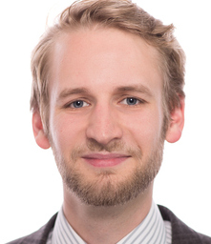
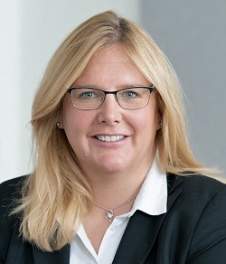
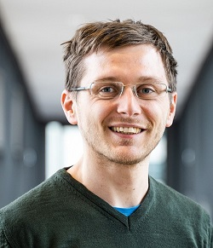




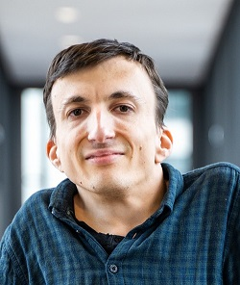
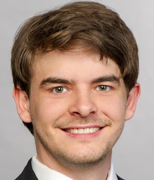
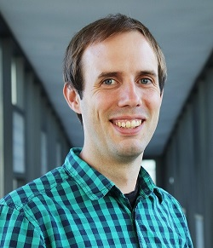

2011-16
2013-16
2017-21
Locomotion Models
Psychology
2017-21
2020-
Uncertainty Quantification
2015-20
2013-17
2018-21
Floorfield Meshing
2019-
Surrogate Models
Simulator Coupling:
Mobile Communication

